Slide 1
Bootstrap CSS Components

Slide 2
Objectives
Understand the need for navigation support in a web project
Use icon fonts for decorating your website with meaningful graphical elements
Create and style buttons on a web page using Bootstrap
Create and style forms on a web page using Bootstrap
Present and style tabular data in a table form using Bootstrap
Display content using a card on a web page
Use images and media and include them in the website
Use thumbnails and media components using Bootstrap
Create, style and include alerts in a web page

Slide 3
Navigation and Navigation Bar

Slide 4
Why Website Navigation?
Websites are rarely single pages
Need to provide visitors an intuitive means of getting around your website
Several commonly used navigation patterns used on websites

Slide 5
Information Architecture
Structure of a system with respect to the way the information is:
Organized,
Labeled, and
Navigation methods provided to access the information
Need to consider when designing websites
Dictates the provisioning of navigation on websites

Slide 6
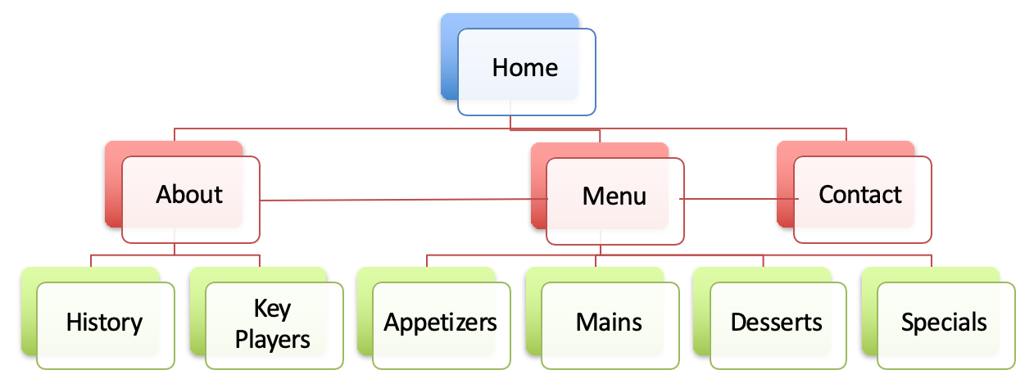
Website Hierarchy

Slide 7
Navigation Bars
Users often expect it at the top of the website
Contains links to various pages within the website

Slide 8
Navigation Bar
Dos and Don’ts:
Use simple, user-friendly terms
Standardize navigation
Provide indication of the location within the navigation hierarchy
Use standard web conventions:
Clicking on a logo takes you back to home page
Have too many items
Use generic labels

Slide 9
Breadcrumbs
Secondary navigation
Usually placed below the primary navigation and above the content
Indicator of the current page’s location within a navigational hierarchy
Path based: set of steps
Location based: hierarchy
Attribute based: set of choices

Slide 10
Other Navigation Aids
Tabs
Pills
Pagination
Dropdowns
Accordion
Tags / Tag clouds
Scrollspy
Affix
We’ll look at them in detail in later modules when we see use cases

Slide 11
Exercise 7: Navbar and Breadcrumbs

Slide 12
Icon Fonts

Slide 13
Icon Fonts
Set of symbols and glyphs
Can be used just like regular fonts
Can be styled with CSS just like regular fonts
Popular lightweight replacement for simple graphics on the website
Many icon font packs available

Slide 14
Some Example Icon Fonts
Font Awesome
Very popular icon font

Slide 15
Using Font Awesome
<i class="fa fa-phone"></i>
Include the CSS files and font files into your project

Slide 16
Bootstrap-social
<a class="btn btn-social-icon btn-facebook" href="http://www.facebook.com/profile.php?id=">
<i class="fa fa-facebook"></i></a>
Uses Bootstrap and Font Awesome icons to create buttons for social media sites
Buttons for all popular social media sites
Include bootstrap-social.css into your project

Slide 17
Exercise 8: Icon Fonts
Use icons within your website to represent various entities making use of the font-awesome icons and bootstrap-social icons

Slide 18
User Input

Slide 19
User Input
User input to a web page can be facilitated through three approaches:
<a> tags to provide hyperlinks
<button> tags to create buttons
<form> to create forms
<input> to create elements in forms

Slide 20
Buttons
Simple interaction
Clicking of the button
Button behavior dependent on where it is positioned:
Inside a form it takes on specific role
General purpose outside
<a> can also be styled using CSS to look like a button

Slide 21
Exercise 9: Buttons

Slide 22
Forms
Form elements:
<input>
type: text, password, submit, radio, checkbox, button, color, date, datetime, email, month, number, range, search, tel, time, url, week
<textarea>
<button>
<select>

Slide 23
Exercise 10: Forms

Slide 24
Bootstrap Tables

Slide 25
Tables
Tables are meant to display tabular data in a web page
Tables have been hijacked by website designers to design and position web content
Here we discuss tables as they are originally meant to be used

Slide 26
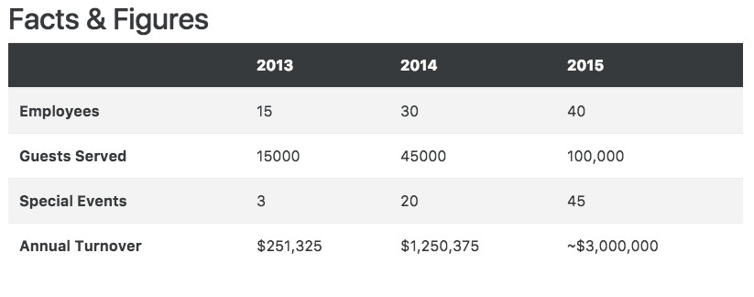
Example Table

Slide 27
Bootstrap Tables
Always start by assigning the table class to tables:
<table class=“table”>
</table>

Slide 28
Bootstrap Tables
table-striped for zebra striped rows
table-bordered for borders to table cells
table-hover for highlighting rows when you hover over a row
table-sm for cutting the cell padding in half
table-responsive for making the tables responsive. Can horizontally scroll tables on screen sizes less than 768px.

Slide 29
Bootstrap Table Contextual Classes
Individual rows or cells can be colored using the following classes: active, success, info, warning and danger
<tr class=“bg-success”> … </tr>
<td class=“bg-danger”> … </td>

Slide 30
Bootstrap Cards

Slide 31
Highlighting Content
Sometimes you may wish to highlight some content on your website
Bootstrap cards are designed for this
Versatile component to display content in myriad ways

Slide 32
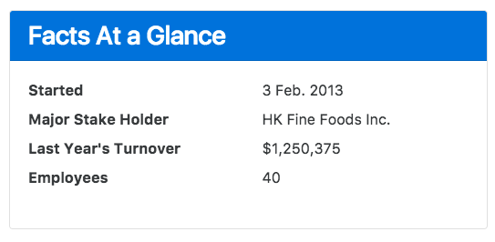
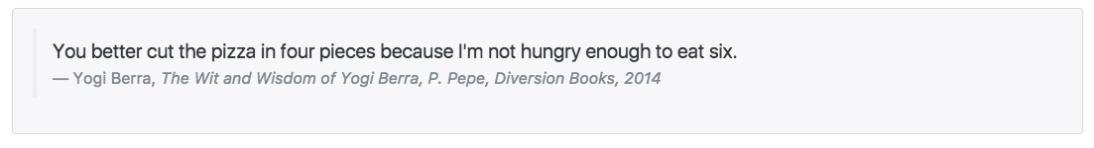
Card

Slide 33
Exercise 11: Displaying Content: Tables and Cards
Create, style and present tabular data in tables in a web page using the Bootstrap table classes
Display content in a web page using Panels and Wells using Bootstrap Panel and Well classes

Slide 34
Images and Media

Slide 35
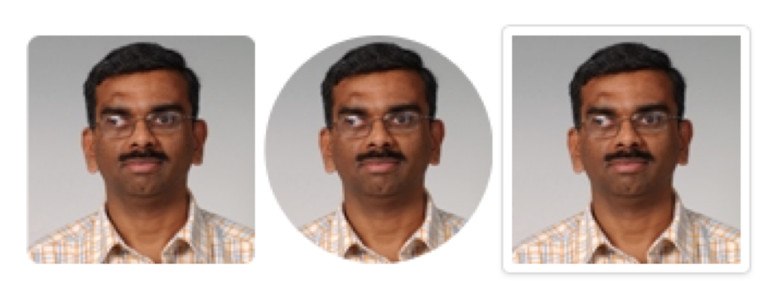
Bootstrap Image Classes
<img src=“…” class=“…” >
img-fluid for responsive images
scales nicely with the parent element
img-thumbnail: thumbnail image
Shape of elements, apply class:
rounded-<top|bottom|right|left>: rounded corners
rounded-circle: circular image

Slide 36
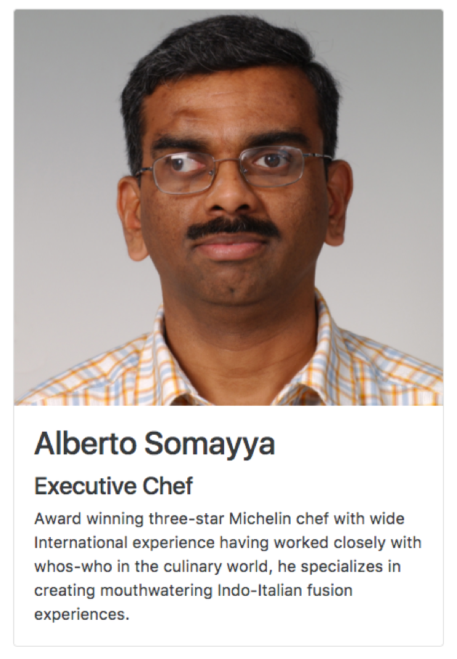
Card Class
<div class="card">
<img class="card-img-top img-fluid”
src="img/alberto-large.png" alt="Alberto Somayya">
<div class="card-body">
<h2 class="card-title">Alberto Somayya</h2>
<h4>Executive Chef</h4>
<p class="card-text">Award winning three-star Michelin chef with wide International experience having worked closely with
whos-who in the culinary world, he specializes in creating mouthwatering Indo-Italian fusion experiences.
</p>
</div>
</div>

Slide 37
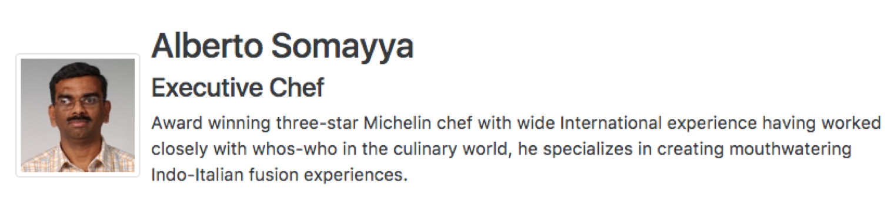
Media Object
<div class="media">
<img class="d-flex mr-3
img-thumbnail align-self-center” src="img/alberto.png” alt="Alberto Somayya">
<div class="media-body">
<h2 class="mt-0">Alberto Somayya</h2>
<h4>Executive Chef</h4>
<p class="hidden-xs-down">Award winning . . . </p>
</div>
</div>

Slide 38

Responsive Embed
<div class="embed-responsive embed-responsive-16by9">
<iframe class="embed-responsive-item” src="https://www.youtube.com/embed/2P2mXutRdkE"></iframe>
</div>

Slide 39
Responsive Embed
Embedding media content, e.g., video, and making it responsive
Apply embed-responsive-item to <embed>,
<iframe>, <video>, <object>
Enclose in <div> and apply embed-responsive and embed-responsive-4by3 or embed-responsive- 16by9

Slide 40
Exercise 12: Images and Media
Use Bootstrap classes to include a responsive images in a website
Use a media object to include images and description on a website

Slide 41
Alerting Users

Slide 42
Alerting Users
Simple updates:
Badges
Alert / Error / Warning messages
Progress Bars

Slide 43
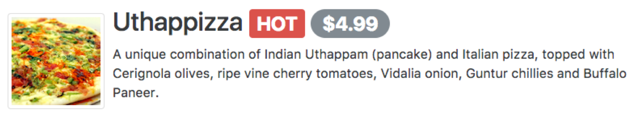
Badges
<h2 class="media-heading">
Uthappizza
<span class=”badge badge-danger">HOT</span>
<span class=”badge badge-pill badge-secondary">$4.99</span>
</h2>

Slide 44
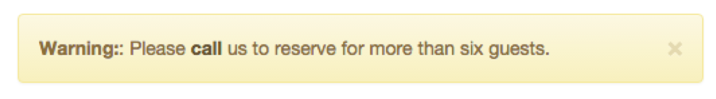
Alerts
<div class="alert alert-warning alert-dismissible" role="alert">
<button type="button" class="close" data-dismiss="alert">
<span>&times;</span>
</button>
<strong>Warning:</strong>: Please
<a href="tel:+85212345678" class="alert-link"> call</a> us to reserve for more than six guests.
</div>

Slide 45
Alerts
<div class=“alert alert-*”> </div>
Alerts in different colors
Can include links in alert
Use alert-dismissible and X button to dismiss alert
Needs Javascript plugin

Slide 46
Progress Bars
<div class="progress">
<div class="progress-bar progress-bar-striped bg-danger" role="progressbar" style="width: 80%">
80%
</div>
</div>

Slide 47
Progress Bars
<div> with progress class
inner <div> with progress-bar class
style= “width:xx %” controls the size
progress-bar-*
colors: primary, danger, …
striped: striped appearance, also use animated for animation
Several can be stacked: include all inner divs in a single outer progress div

Slide 48
Exercise 13: Alerting Users
Add badges to your web page using the Bootstrap badge class

Slide 49
Summary
Understand the need for navigation support in a web project
Use icon fonts for decorating your website with meaningful graphical elements
Create and style buttons on a web page using Bootstrap
Create and style forms on a web page using Bootstrap
Present and style tabular data in a table form using Bootstrap
Display content using a card on a web page
Use images and media and include them in the website
Use thumbnails and media components using Bootstrap
Create, style and include alerts in a web page

